Slide 1



Fluency in Large-Scale Agile Development
Pontifícia Universidade Católica do Rio Grande do Sul
Faculdade de Informatica
Graduate Program in Computer Science
Research Plan Proposal (PEP)
January 2016
student: Greice Roman
supervisor: Sabrina Marczak

Slide 2
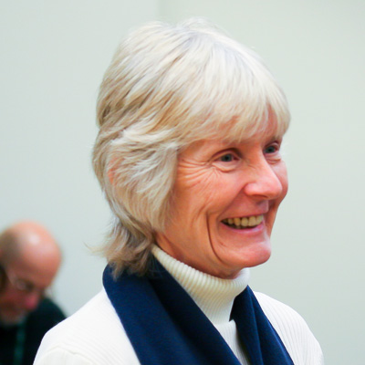
“
In our experimentation with Scrum (…) we found that small teams can be flexible and adaptable.
”
LINDA RISING AND NORMAN S. JANOFF
AG COMMUNICATION SYSTEMS, 2000
Notes:
Linda Rising em 2000 publicou um artigo na IEEE Software relatando o seu caso de sucesso ao adotar Scrum (método ágil).

Slide 3





sixteen years go by...
Agile Conference ‘09
IBM Global Services ‘10
Information and Software Technology ‘11
ESEM ‘13
Addison-Wesley Professional ‘12
Notes:
Desde então 15 anos se passaram e diversas outras empresas e até mesmo empresas que não são do segmento de TI acreditaram na adoção dos métodos ágeis e implementaram a metodologia em seus processos de desenvolvimento por diversas motivações.

Slide 4

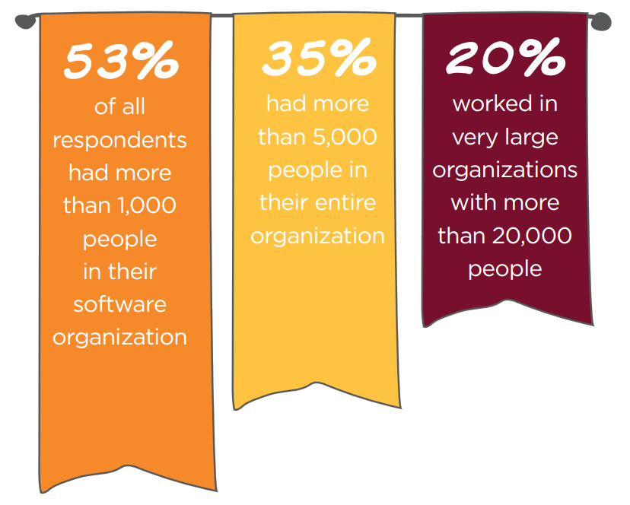

Slide 5
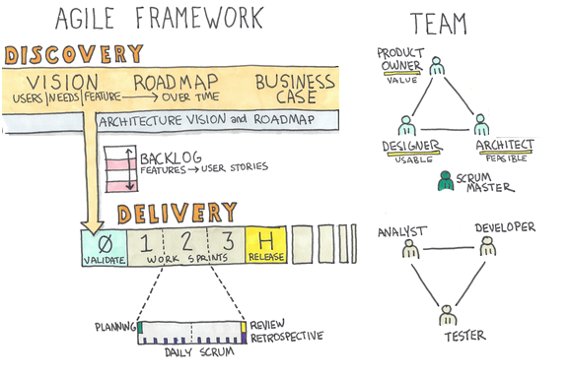
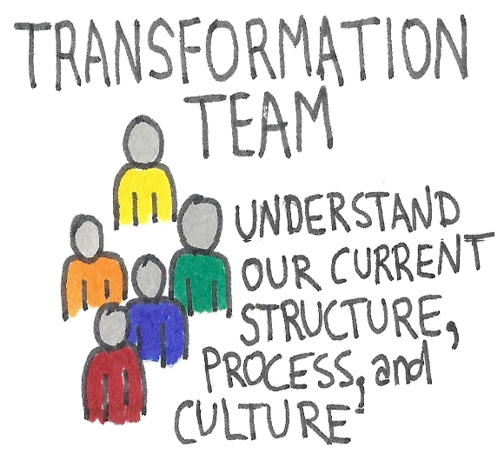
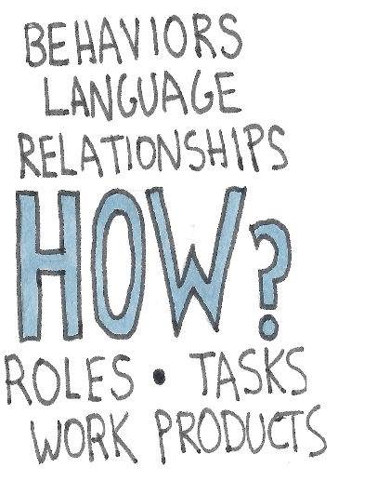


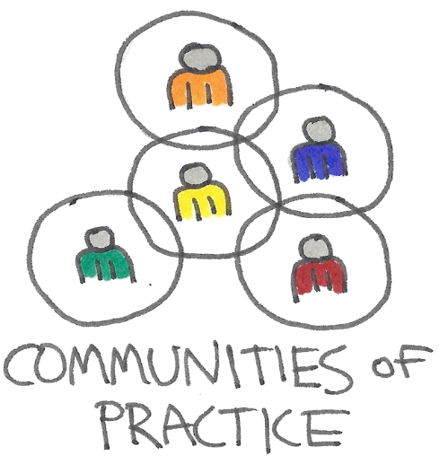
some practices for agile transformation

Slide 6
The term ’scaled agile development’ was introduce in academia by Sutherland in his study "Agile can Scale“.
Five large companies adopt Scrum method.
Sutherland, J. “Agile can scale: Inventing and reinventing scrum in five companies”, Cutter IT journal, vol. 14–12, 2001, pp. 5–11

Slide 7
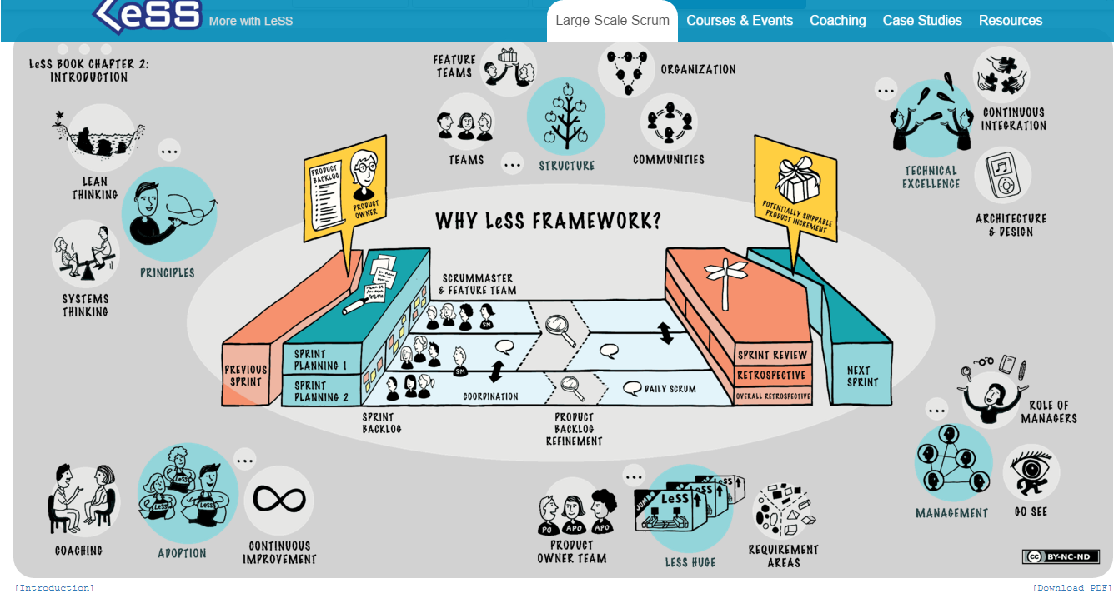
Scaled Agile Development
Safe, Less, DaD,
Scaled Agile Development

Slide 8
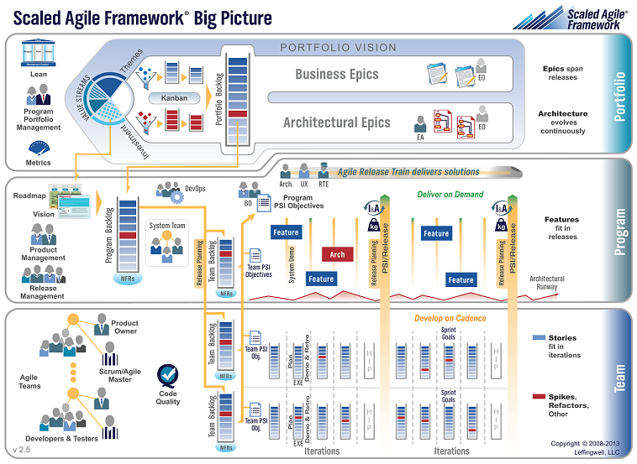
Safe, Less, DaD,
Scaled Agile Development

Slide 9
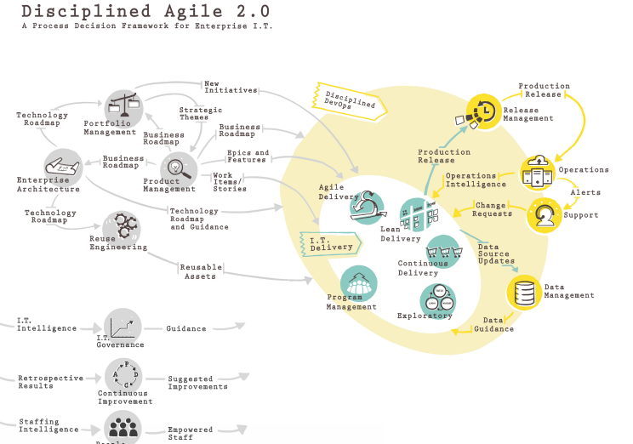
Safe, Less, DaD,
Scaled Agile Development
Notes:
IBM FRAMEWORK -> DAD ->

Slide 10
Although the proposals above, being an ’agilist’ involves more than merely adopting practices or frameworks.
Teams and organizations need to acquire maturity and master new behaviors and change culture.
Ranganath, P. “Elevating teams from ’doing’ agile to ’being’ and ’living’ agile”. In: Proceedings of the Agile Conference, Salt Lake City, USA, IEEE Press, 2011, pp. 187–194.

Slide 11
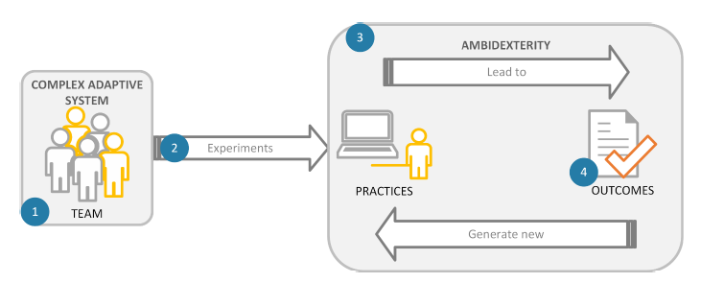
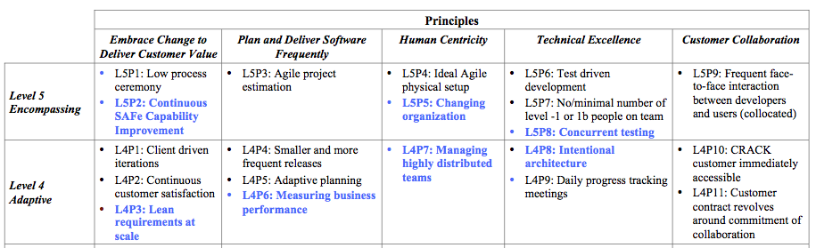
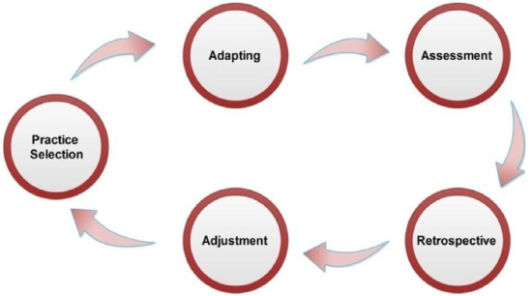
Maturity Models
Fontana et. al. ‘15
The Journal of Systems and Software
Stojanov, Turetken, and Trienekens’15
Euromicro Conference
Gandomani and Nafchi ’15
The Journal of Systems and Software

Slide 12
The Problem
There are also only a few studies based on the aspects and principles related to scaled agile development, but none of them discusses extensively and comprehensively what characterizes this scenario and what it means to teams acquire fluency in this setting. My work aims to fill in this gap.
The term ’fluency’ refers to the scaled-teams’ maturity to perform in large-scale agile development

Slide 13
Research Question
What are the aspects and stages involved in large-scale agile development that can be used for teams to acquire fluency in this setting?

Slide 14
My proposal
To characterize fluency in large-scale agile software development

Slide 15
Objectives
(Obj1) To understand the related concepts of Agile Development, Agile Transformation and Fluency in Agile Development;
(Obj2) To identify the literature state of art in Large-Scale Agile Development;
(Obj3) To identify the aspects and stages of fluency in Large-Scale Agile Development in practice;
(Obj4) To define a Fluency Framework based on the findings from Objectives 1 to 3;
(Obj5) To preliminarily evaluate the proposed Fluency Framework in order to shed some light on its applicability in practice.

Slide 16
Methodology
Phase 1
Theoretical Proposal
Foundation
Phase 3
Obj1 + Obj2
Obj4
Literature Review
Benchmarking
Fluency Fram.
Phase 2
Phase4
Obj3
Obj5
Field Study
Member Checking
Empirical Work
Evaluation

Slide 17
Foundation
Phase 1
Obj1 + Obj2
Related Concepts
Agile Development, Agile Transformation, Agile Fluency
Literature Review
Systematic Review
Large-Scale Agile Development
Benchmarking
To explore what companies have done
XP Conference + Agile Brazil Conference

Slide 18
Empirical Work
Phase 2
Obj3
Field Study
Interviews with industry personnel
(Agile Experts)

Slide 19
Theoretical Proposal
Phase 3
Obj1 + Obj2
Foundation
Obj4
Phase 1
Phase 2
Fluency
Framework
Empirical Work
Obj3
Framework: a set of concepts and recomandations
that helps to guide the implementation of a process

Slide 20
Evaluation
Phase4
Obj5
Member Checking
To refine the framework proposed
with the same people of phase 2 and more

Slide 21
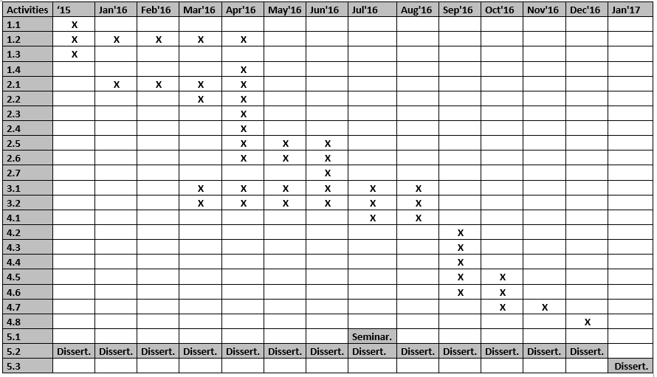
Schedule

Slide 22
Schedule

Slide 23
Schedule

Slide 24
Schedule

Slide 25
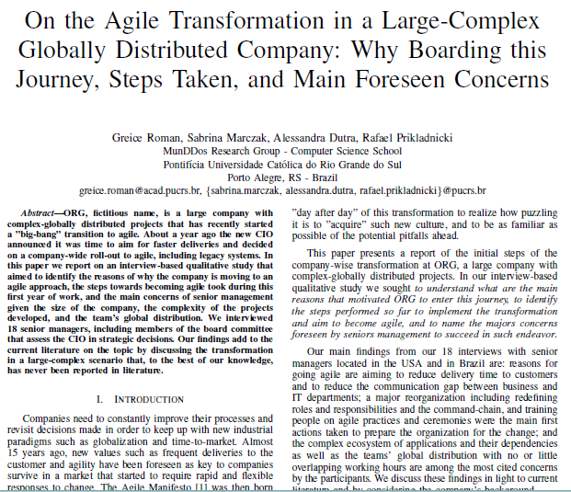
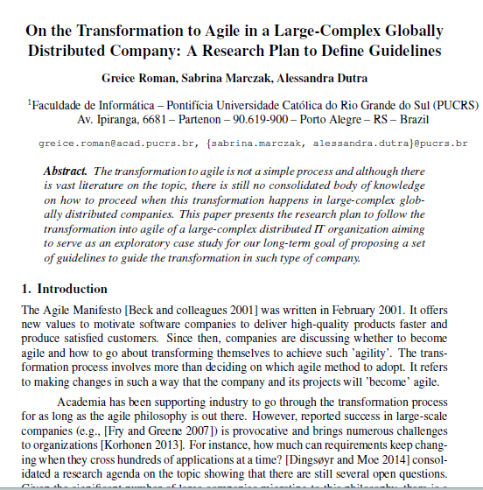
Accepted Papers
Roman, Marczak, Dutra ’15
(ELA-ES)
Roman et. al.’15
(WBMA)

Slide 26
Fluency in Large-Scale Agile Development
Pontifical Catholic University of Rio Grande do Sul
Faculty of Informatics
Undergraduate Program in Computer Science
Presentation of Plan of Study and Research
January 2016
student: Greice Roman
supervisor: Sabrina Marczak

